Slide 1
SSWAA – QuaverSEL Collaboration
School Year 2020/21

Slide 2
History
February 2020: QuaverSEL Co-Founder Graham Hepburn connected with SSWAA’s Executive Director to explore possible collaboration
April 6, 2020: First meeting with QuaverSEL, SSWAA, and UoI.
  Align QuaverSEL standards to SSWAA SEL National Standards
  Invitation to SSWAA members to sign up for free digital access
June 30, 2020: 128 members expressed interest (76 signed up)
September 18, 2020: Kick Off Meeting with Cohort
June 7, 2021: Celebration Event

Slide 3
Overview (Members who logged on once)
Number of members who logged on once (Semester 1): 35
  Highest: 503 times Average: 98 times (SD: 124.53) Median: 50 times
Number of members who logged on once (Semester 2): 33
Highest: 588 times Average: 104 times (SD: 146.05) Median: 38 times
Number of members who logged on once (Both): 40
Highest: 1045 times Average: 172 times (SD: 246.85) Median: 71 times

Slide 4
Overview (Members who completed survey)
Number of members who completed survey (Semester 1): 12
Highest: 457 times Average: 174 times (SD: 150.48) Median: 140 times
Number of members who completed survey (Semester 2): 15
Highest: 588 times Average: 146 times (SD: 168.93) Median: 81 times
Number of members who completed survey (Both): 9
Highest: 1045 times Average: 351 times (SD: 340.51) Median: 216 times

Slide 5
What are the most popular activities? (n=40)
Semester 1
1. I am Happy
2. Prepare Your Body
3. Sharing Happiness
4. When I Feel Angry
5. Identifying Strong Feelings
6. Following Rules
7. Understanding my Feelings
8. Rules Help Us
9. Dealing with Multiple Feelings
10. Benefits of Self Discipline
Semester 2
1. Prepare Your Body
2. I am Happy
3. Understanding my Feelings
4. Positive Mindset
5. Rules Help Us
6. Practicing my Self Control
7. Identifying Strong Feelings
8. Sharing Happiness
9. I Feel Overwhelmed
10. The Golden Rule
Overall
1. Prepare Your Body
2. I am Happy
3. Sharing Happiness
4. When I feel Angry
5. Identifying Strong Feelings
6. Understanding My Feelings
7. Rules Help Us
8. Following Rules
9. Dealing with Multiple Feelings
10. Listening to Others

Slide 6
When do SSWs Access Quaver? – Month of the Year

Slide 7
When do SSWs Access Quaver? – Day of the Week (Semester 1)

Slide 8
When do SSWs Access Quaver? – Day of the Week (Semester 2)

Slide 9
When do SSWs Access Quaver? – Day of the Week (Overall)

Slide 10
When do SSWs Access Quaver? – Time of the Day (Semester 1)

Slide 11
When do SSWs Access Quaver? – Time of the Day (Semester 2)

Slide 12
When do SSWs Access Quaver? – Time of the Day (Overall)

Slide 13
Is There a Difference in Usage …
If you are an SEL lead?

Slide 14
Is There a Difference in Usage …
If you have an SEL team?

Slide 15
Is There a Difference in Usage …
If you are already using an existing program?

Slide 16
Is There a Difference in Usage …
If you are in a large (> 7 schools) vs small district?

Slide 17
Is There a Difference in Usage …
If you are in a large (>500 students) vs small school?

Slide 18
Is There a Difference in Usage …
If you are in a high poverty (>50%) vs low school?

Slide 19
Is There a Difference in Usage …
If you are in a very high poverty (>70%) vs low school?

Slide 20
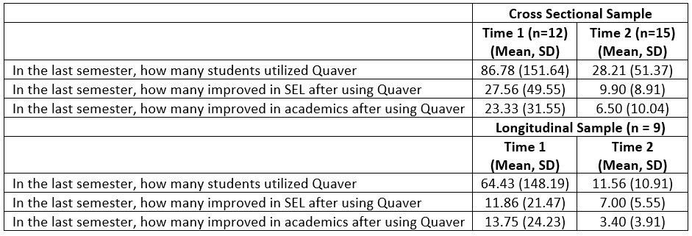
Students who utilized Quaver, SEL, and Academics

Slide 21
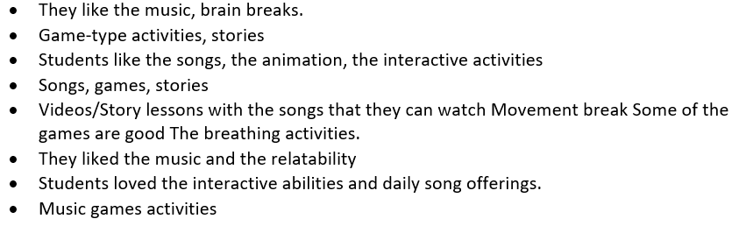
Overall, what did students like about QuaverSEL? (Sem 1)

Slide 22
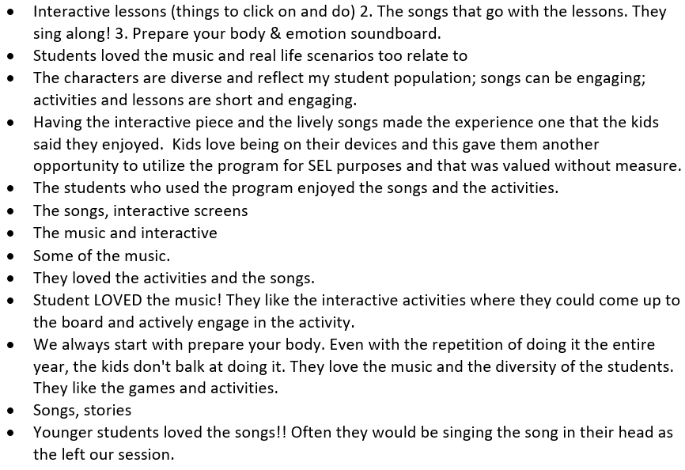
Overall, what did students like about QuaverSEL? (Sem 2)

Slide 23
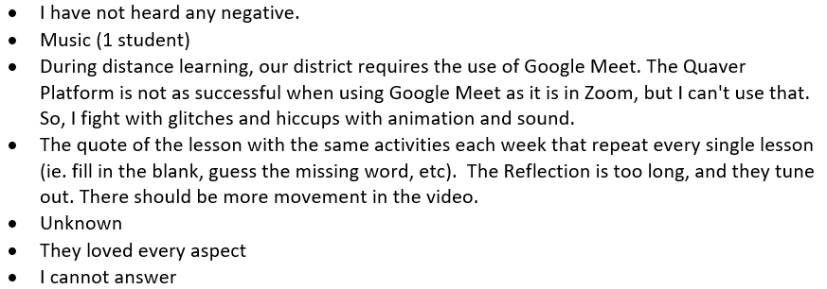
What do students not like about QuaverSEL? (Sem 1)

Slide 24
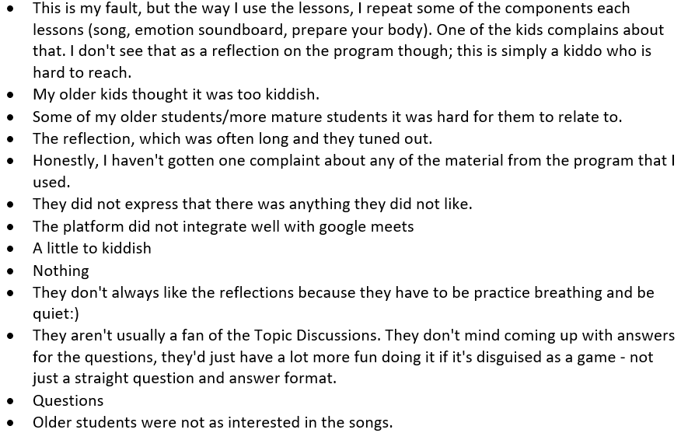
What do students not like about QuaverSEL? (Sem 2)

Slide 25
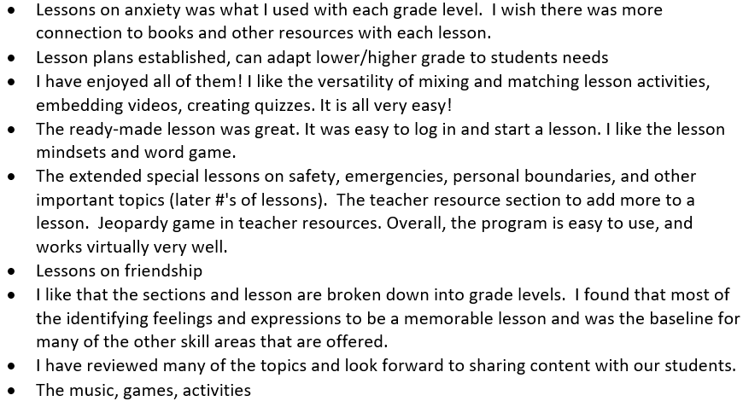
What was easy to use in QuaverSEL? What particular lessons/activities do you remember going especially well? (Sem 1)

Slide 26
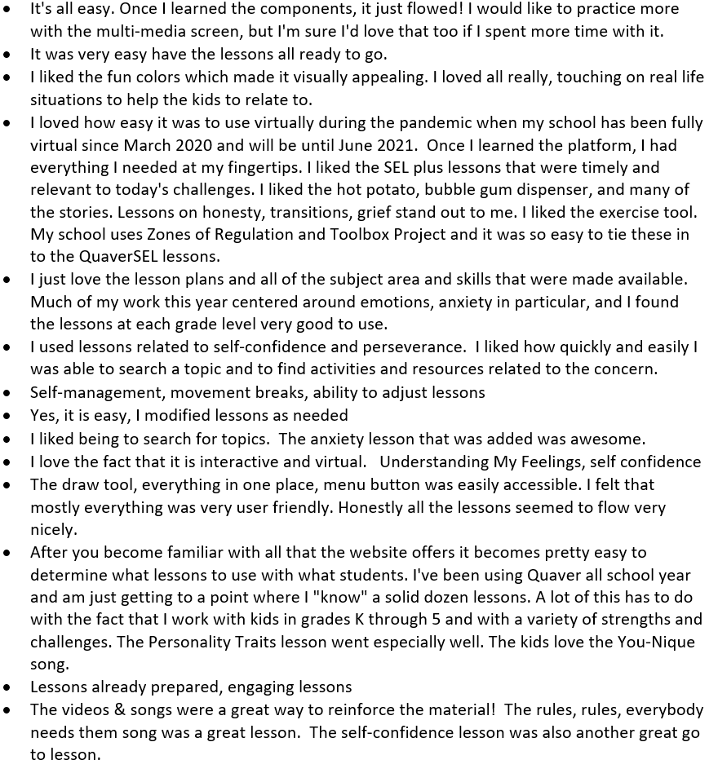
What was easy to use in QuaverSEL? What particular lessons/activities do you remember going especially well? (Sem 2)

Slide 27
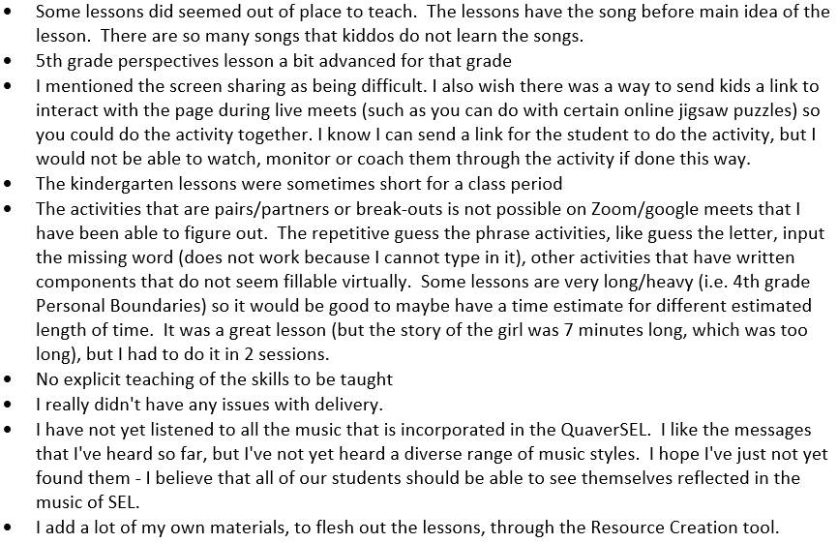
What was challenging about QuaverSEL? What lessons/activities did you remember not going well? (Sem 1)

Slide 28
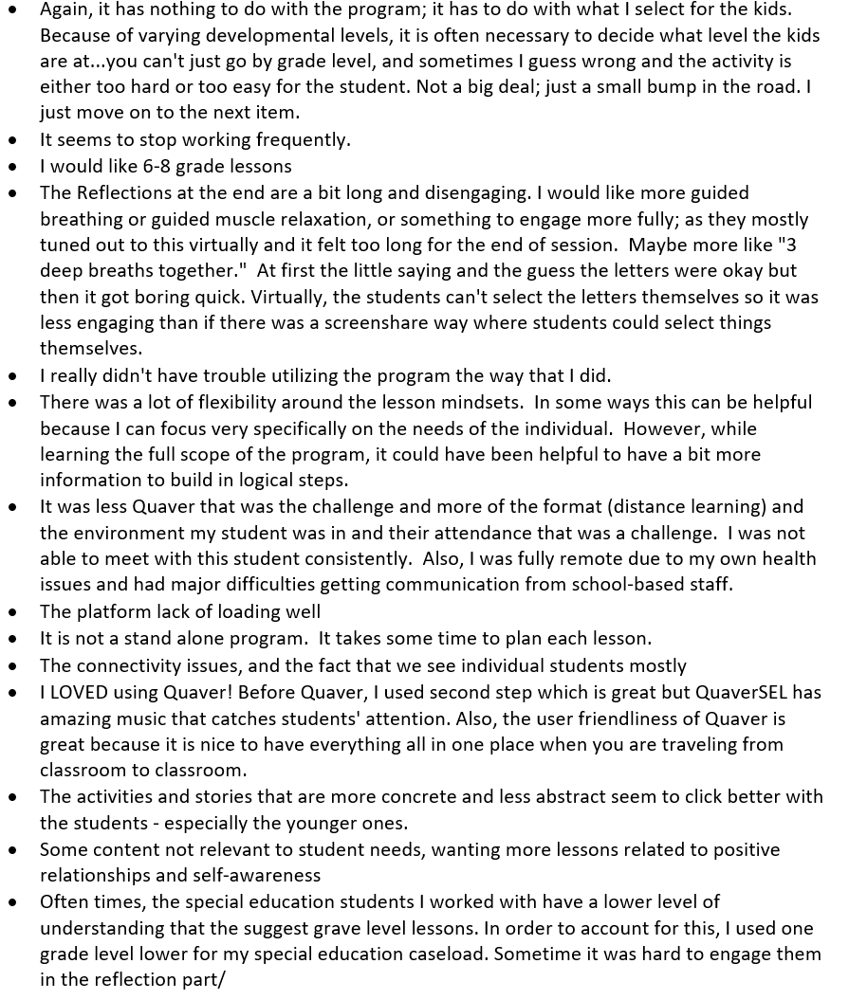
What was challenging about QuaverSEL? What lessons/activities did you remember not going well? (Sem 2)

Slide 29

School Social Workers who responded to the survey ……

Slide 30
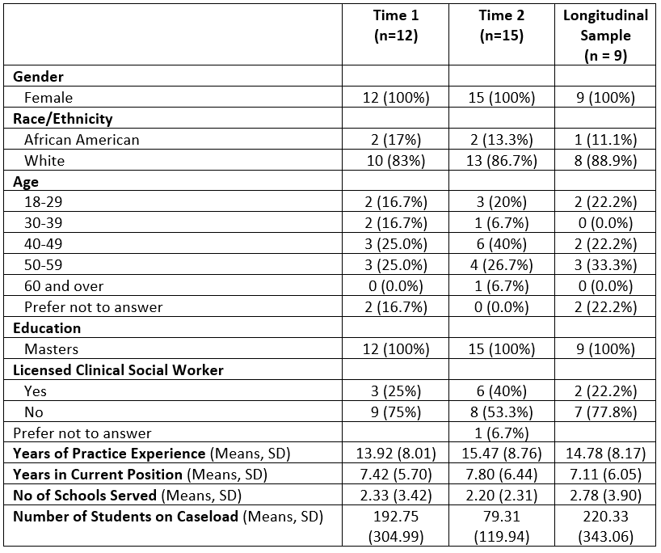
Demographics

Slide 31
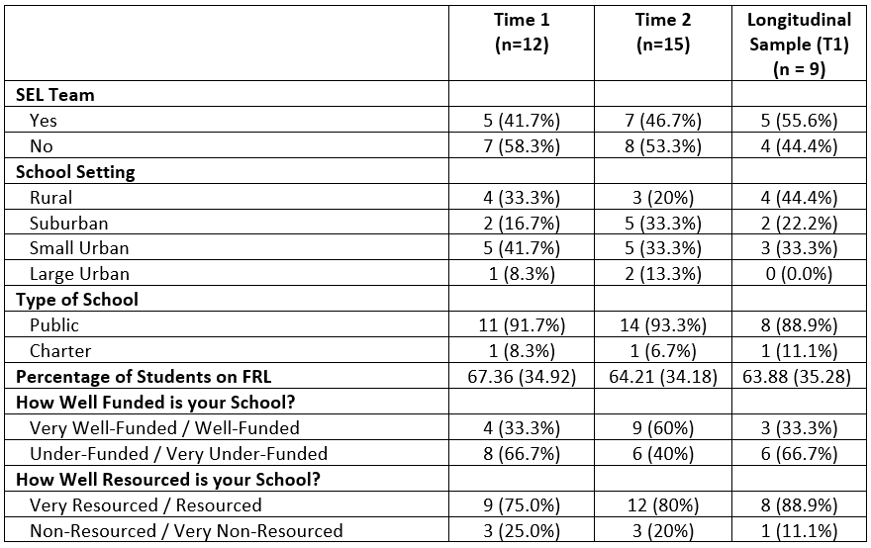
School Information

Slide 32
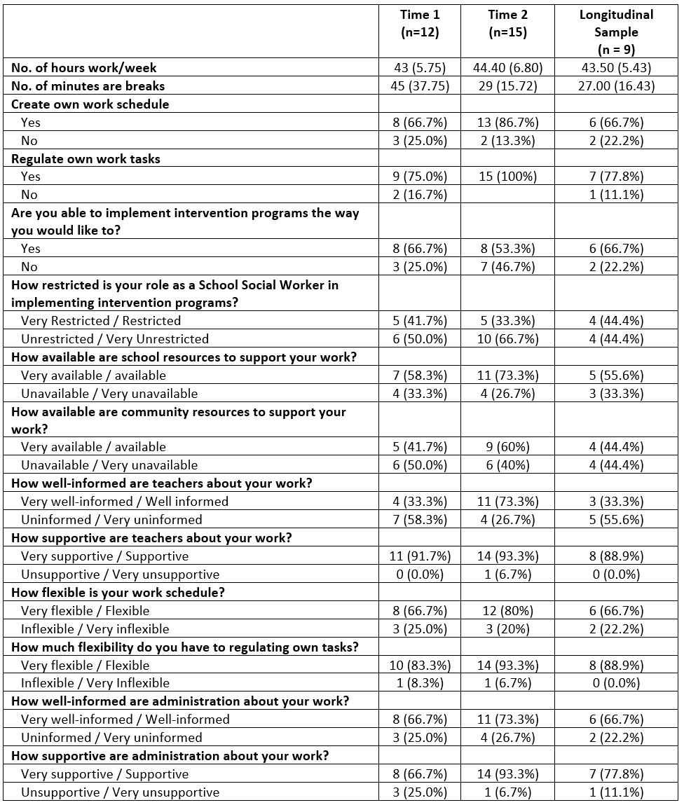
Work Environment

Slide 33
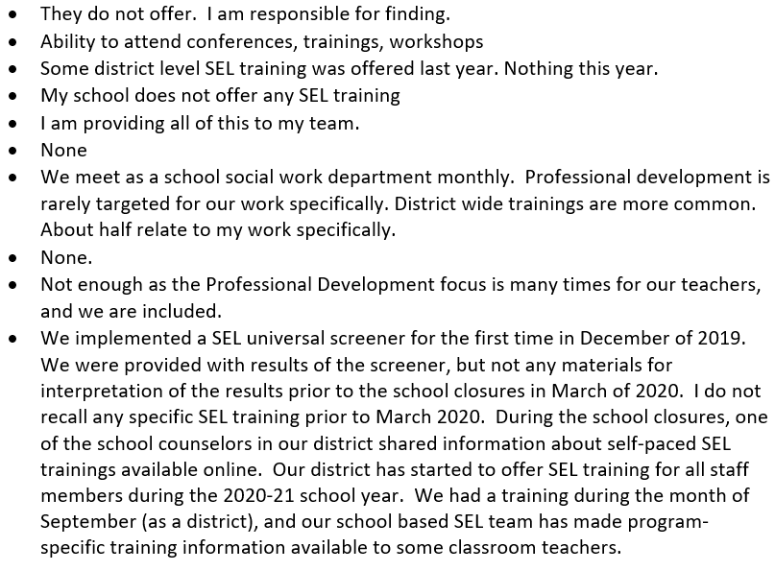
What PD does your school offer on SEL?
(Sem 1 Responses)

Slide 34
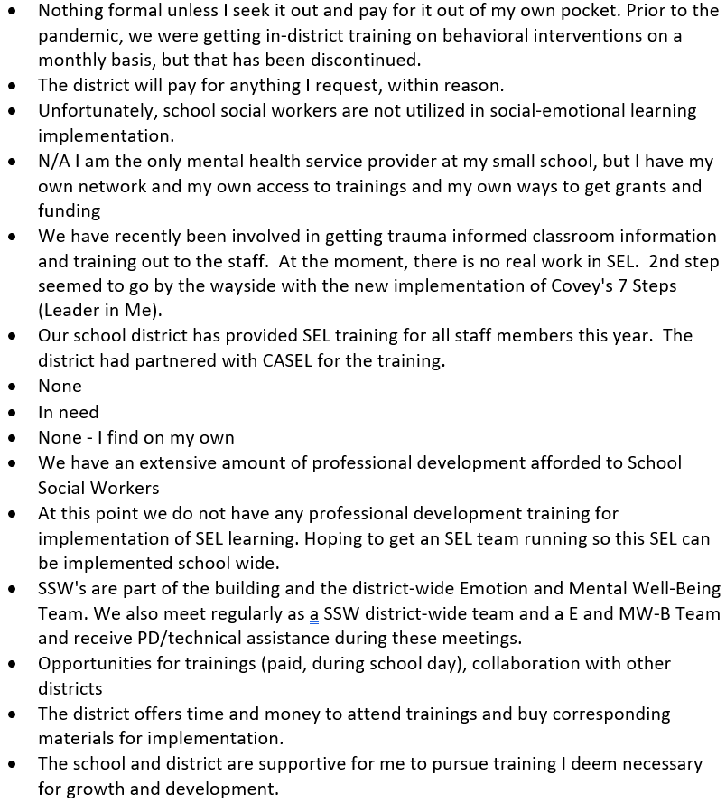
What PD does your school offer on SEL?
(Sem 2 Responses)

Slide 35
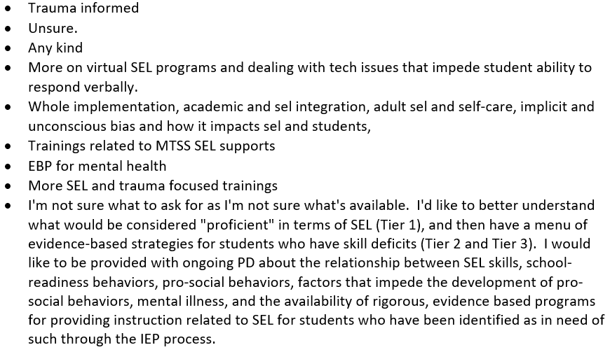
What kinds of training would you like to have, but do not have? (Sem 1 Responses)

Slide 36
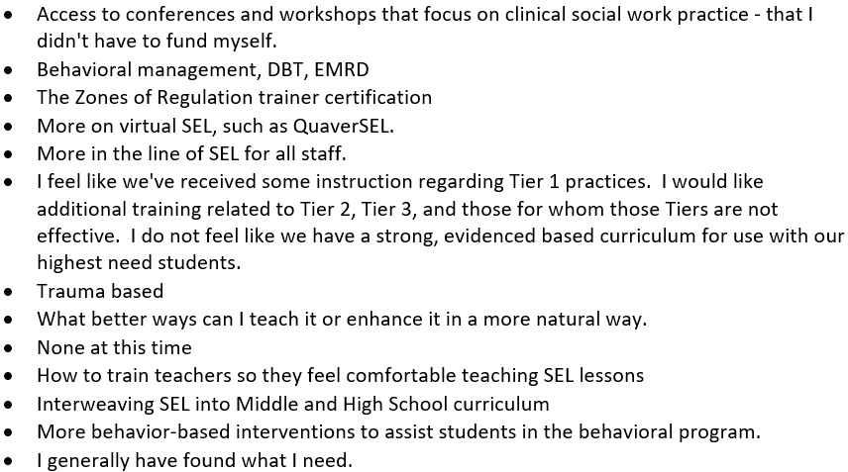
What kinds of training would you like to have, but do not have? (Sem 2 Responses)

Slide 37
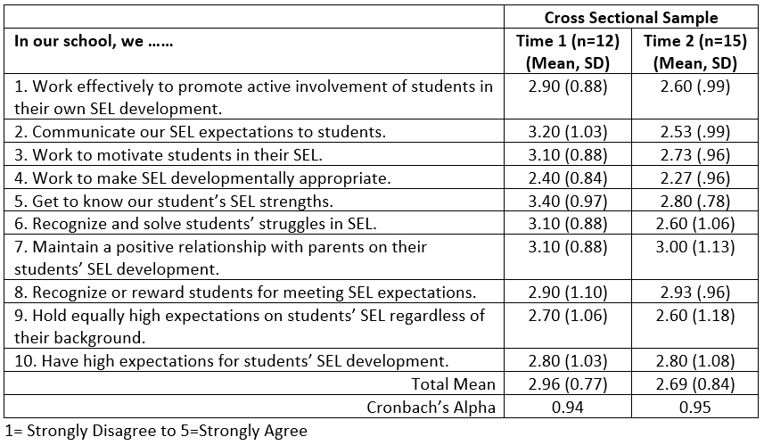
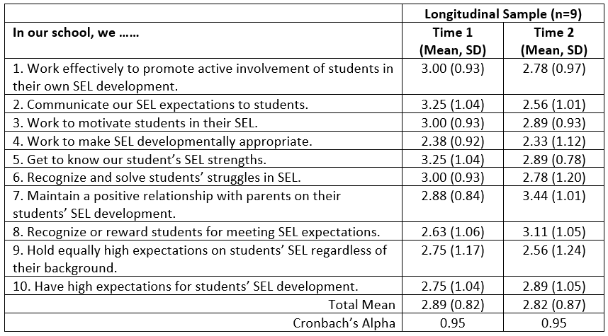
Student Needs and Expectations Around SEL

Slide 38
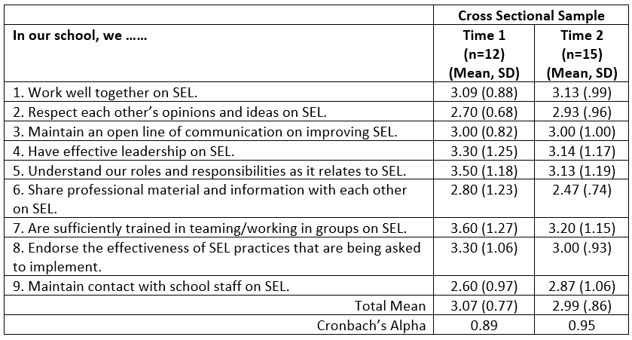
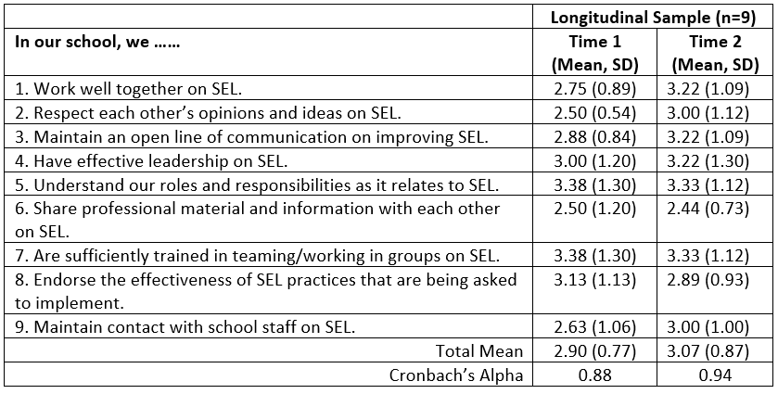
Team Cohesion and Readiness for Training

Slide 39
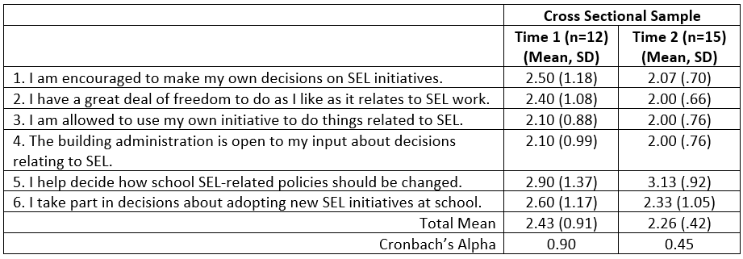
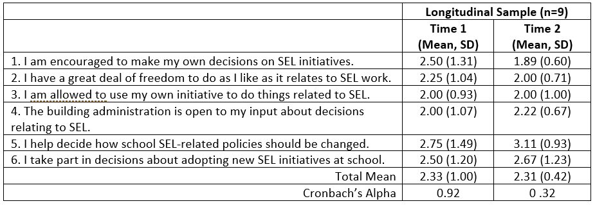
School Decision Making

Slide 40
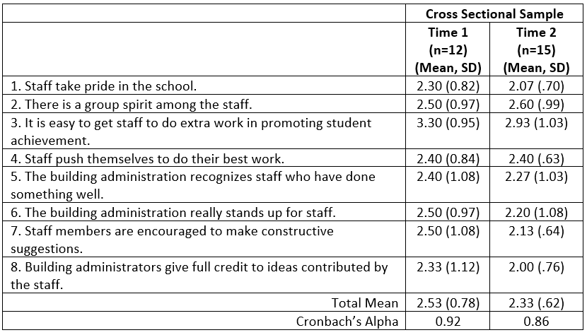
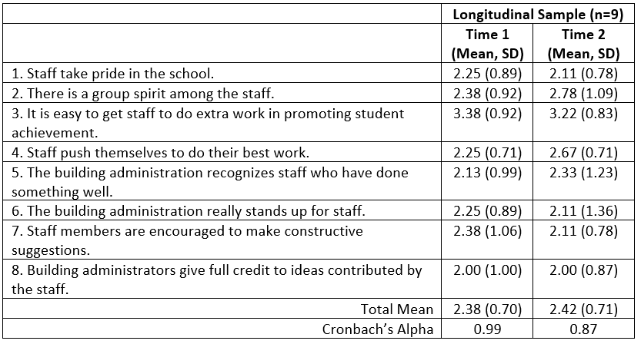
Staff Work Climate

Slide 41
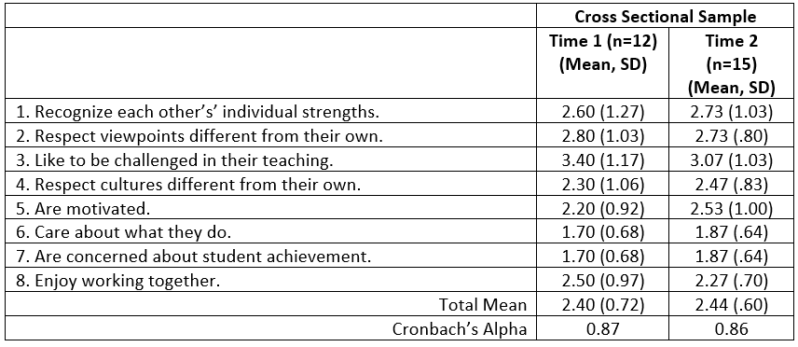
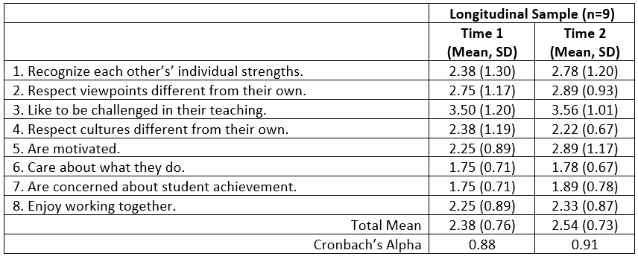
School Climate

Slide 42
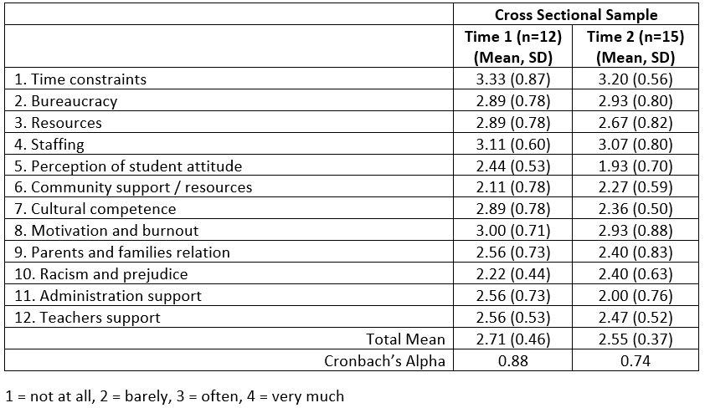
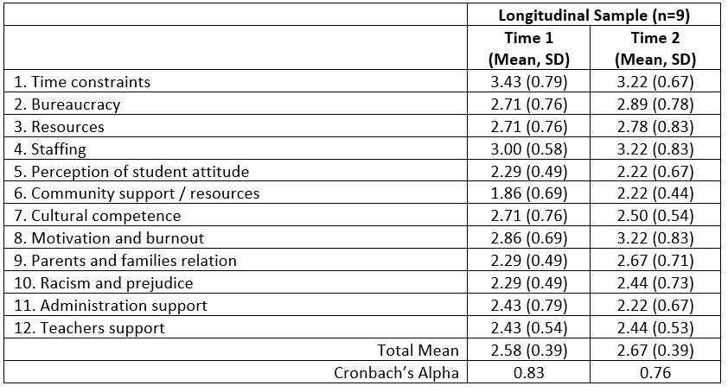
Barriers to Practice Intervention

Slide 43
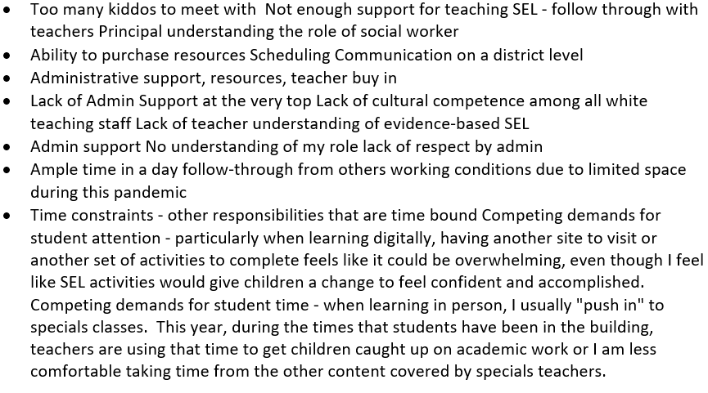
List the Top 3 barriers to your SEL Practice
(Sem 1)

Slide 44
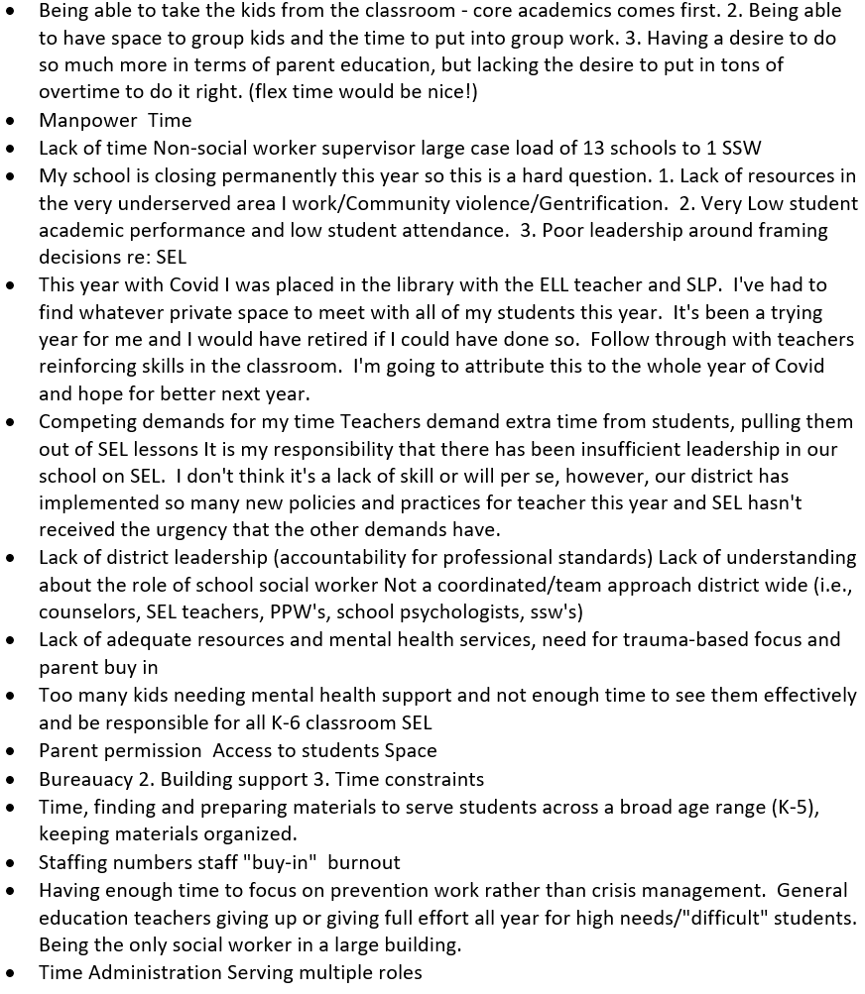
List the Top 3 barriers to your SEL Practice
(Sem 2)

Slide 45
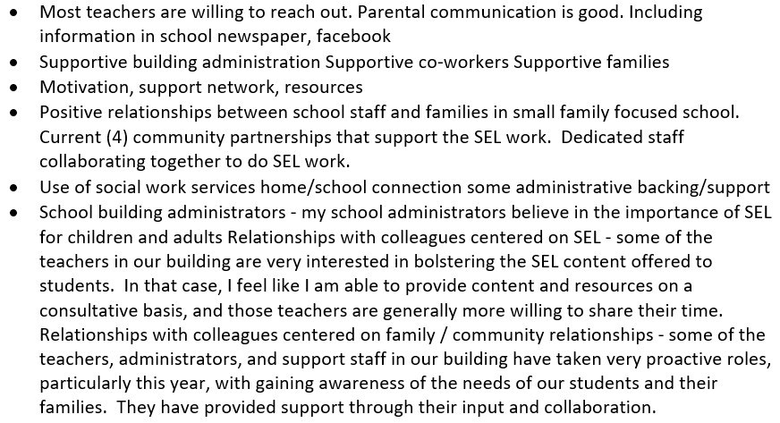
Top 3 Factors that Support / Facilitate Your Practice (Sem 1)

Slide 46
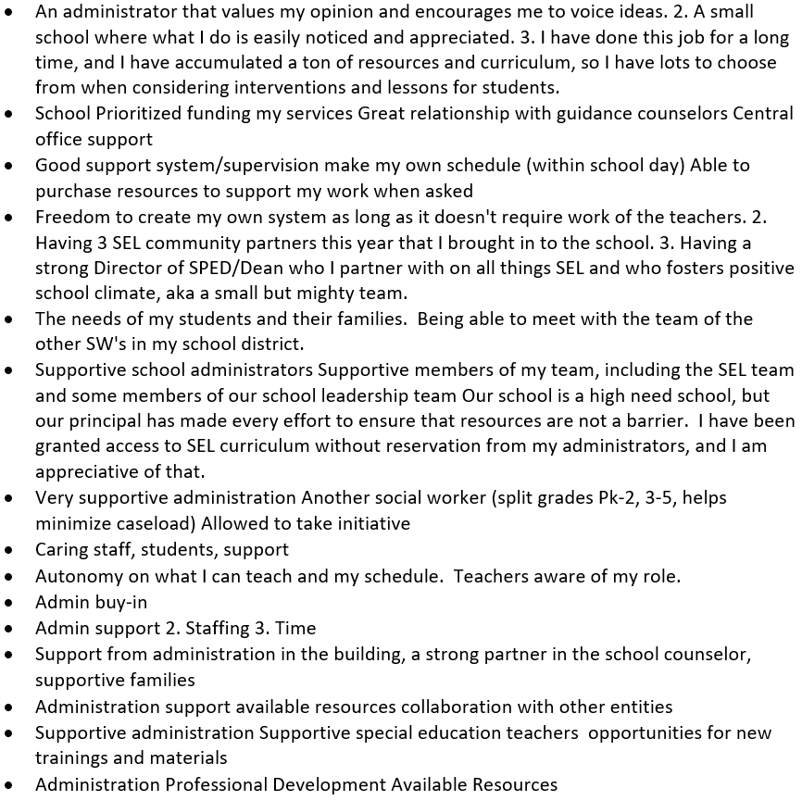
Top 3 Factors that Support / Facilitate Your Practice (Sem 2)

